Slide 1

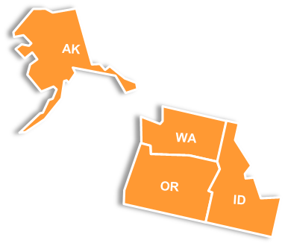

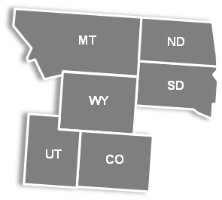
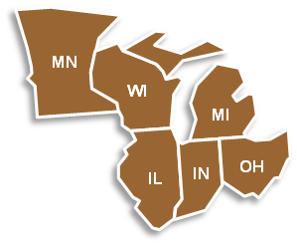

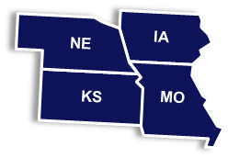
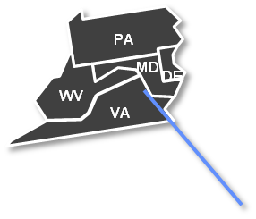
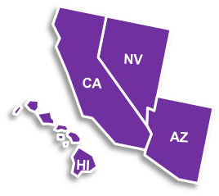
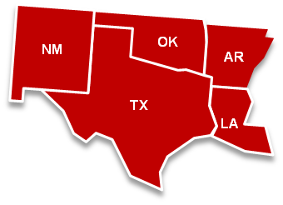
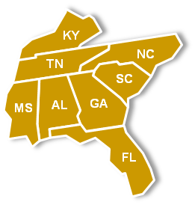
Pegasys Functional Coordinators
Region 10
Region 8
Region 5
Region 1
FC: Tamira Mitchell
PBS Backup: Linda Petorak
PBS FC: Sharon Kajewski
FAS FC: Susan Marquez
PBS Backup: Shirly Longihini-Owen
FAS Backup: Laura Roberts
PBS FC: Amanda MacKenzie
FAS FC: Sara Haegele
FC: Rudolph Agnite
Region 2
PBS FC: Joe Musolino
FAS FC: Lynn Zhao
Region 3
PBS FC: Maria McDermott
FAS FC: Jacki Skinner
FAS Backups: Vanessa Nguyen & Patti Mullen
Region 11 (NCR)
FC: Anthony Marable
FC: Gail Hairston
FC: Adrienne Wilkins
Region 9
Region 6
FC: Sandy Hom
Backup: Hoa Hua
FC: Gene Moraine
Backup: William McKaig
Region 7
Region 4
FC Michelle Watts
FC: Greta Carter
Backup: Janice Evans

Slide 2
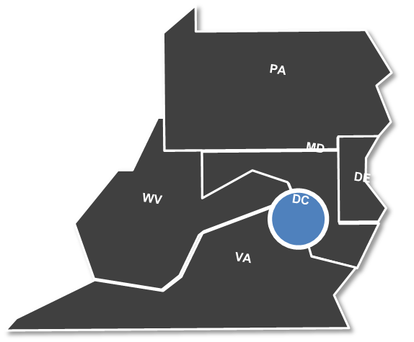
Pegasys Service Representatives
Central Office
FC & SR Lead: Larry Sampson
Pegasys Purchase Card FC: Bridget Jones
BDR Support: Joyce Deanell
BDR Support: Michelle Wells
PBS Service Representative: Mark Grgurich
PBS Service Representative Backup: Claudine Schleicher
FAS Service Representative: Hilary Pritt
FAS Service Representative Backup: Candy Penix
GM&A Service Representative: Ellis Dyson
IG Service Representative: Suzanne Melnick
FCIC Service Representative: Ahmed El-Aref

